Slide 1
Data Science
CSE-4075
Unsupervised Learning
(Hierarchical Clustering)

Slide 2
Unsupervised Learning
Clustering
Unsupervised classification, that is, without the class attribute
Want to discover the classes
Association Rule Discovery
Discover correlation

Slide 3
Technique Characteristics
Hard vs Fuzzy
Hard clustering assigns each instance to one cluster
fuzzy clustering assigns degree of membership
Monothetic vs Polythetic
Polythetic: all attributes are used simultaneously, e.g., to calculate distance (most algorithms)
Monothetic: attributes are considered one at a time
Incremental vs Non-Incremental
With large data sets it may be necessary to consider only part of the data at a time (data mining)
Incremental works instance by instance

Slide 4
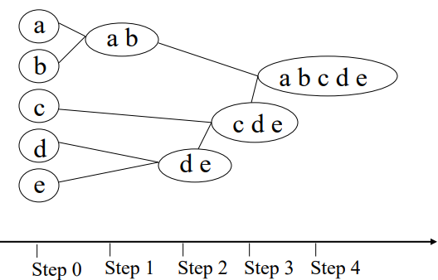
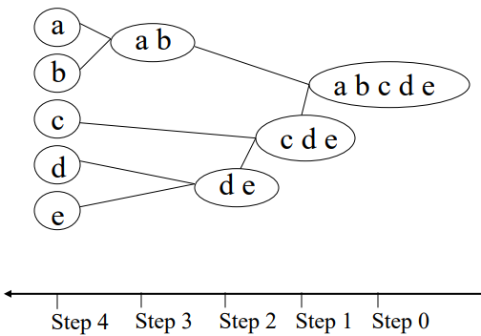
Hierarchical Clustering
A hierarchical clustering is a set of nested clusters that are organized as a tree.
Agglomerative vs Divisive
Agglomerative: each instance is its own cluster and the algorithm merges clusters
Divisive: begins with all instances in one cluster and divides it up
Agglomerative
Divisive

Slide 5
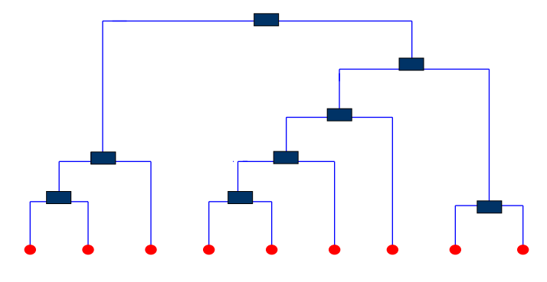
Dendrogram
A tree that shows how clusters are merged/split hierarchically
Each node on the tree is a cluster; each leaf node is a singleton cluster

Slide 6
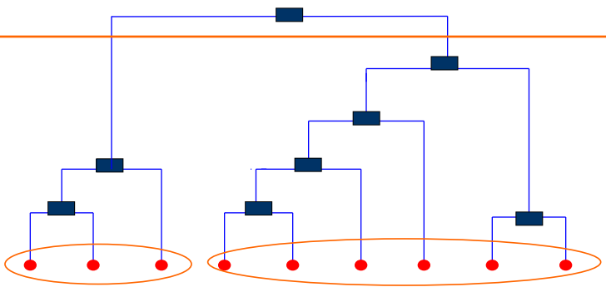
Dendrogram
A clustering of the data objects is obtained by cutting the dendrogram at the desired level, then each connected component forms a cluster

Slide 7
Agglomerative Clustering Algorithm
More popular hierarchical clustering technique
Basic algorithm is straightforward
1. Compute the distance matrix
2. Let each data point be a cluster
3. Repeat
4. Merge the two closest clusters
5. Update the distance matrix
6. Until only a single cluster remains
Key operation is the computation of the distance between
two clusters
Different approaches to defining the distance between clusters
distinguish the different algorithms

Slide 8
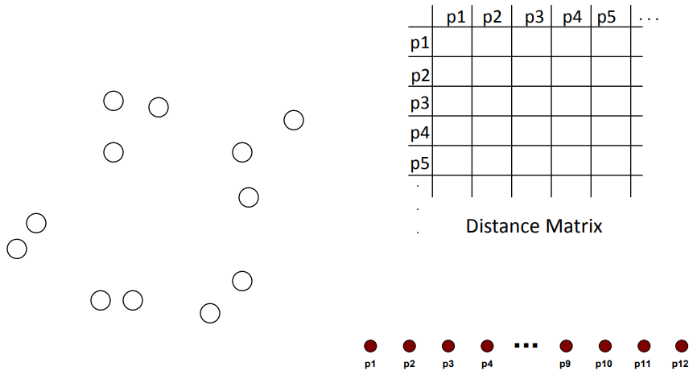
Starting Situation
Start with clusters of individual points and a distance matrix

Slide 9
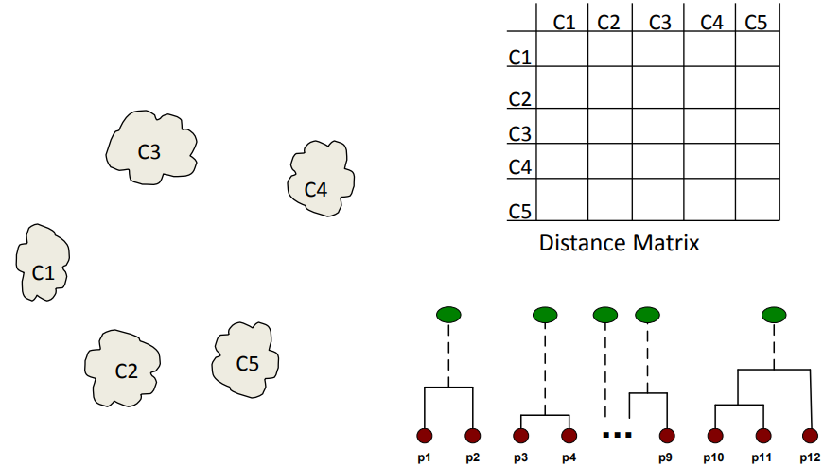
Intermediate Situation
After some merging steps, we have some clusters
Choose two clusters that has the smallest distance (largest similarity) to merge

Slide 10
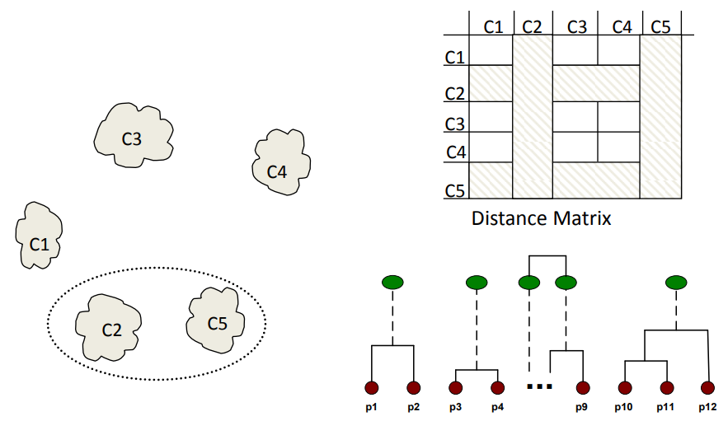
Intermediate Situation
We want to merge the two closest clusters (C2 and C5) and update the distance matrix.

Slide 11
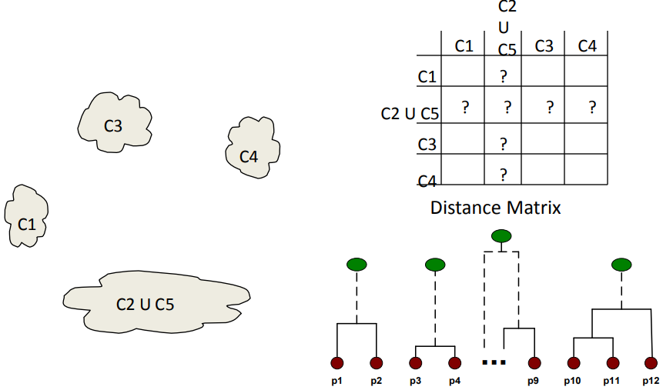
After Merging
The question is “How do we update the distance matrix?”

Slide 12
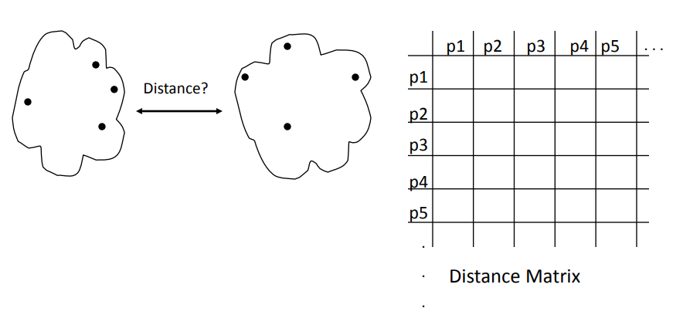
How to Define Inter-Cluster Distance
Single link method (Min)
Complete link method (Max)
Average link (group Average)
Centroid method (Distance between centriods)

Slide 13
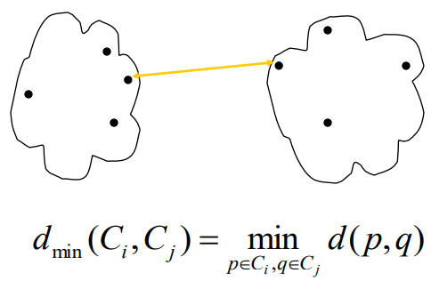
Single link method (Min)
The distance between two clusters is represented by the distance of the closest pair of data objects belonging to different clusters.
Determined by one pair of points, i.e., by one link in the proximity graph

Slide 14
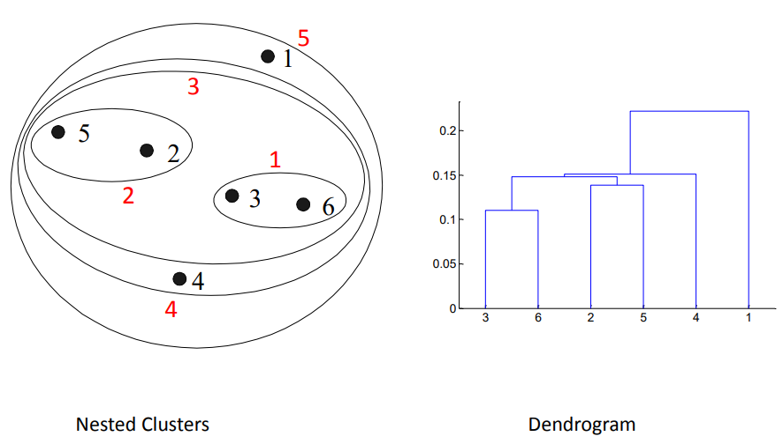
Single link method (Min)

Slide 15
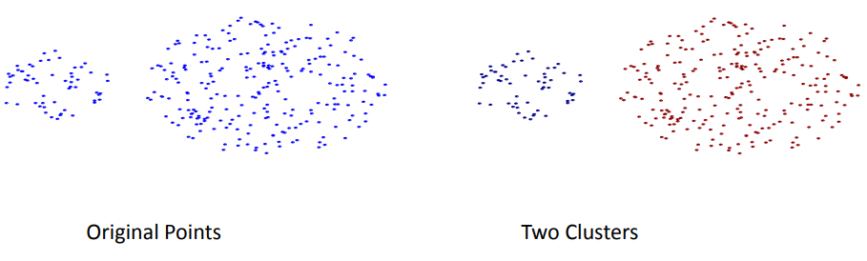
Single link method (Min)
Can handle non-elliptical shapes

Slide 16
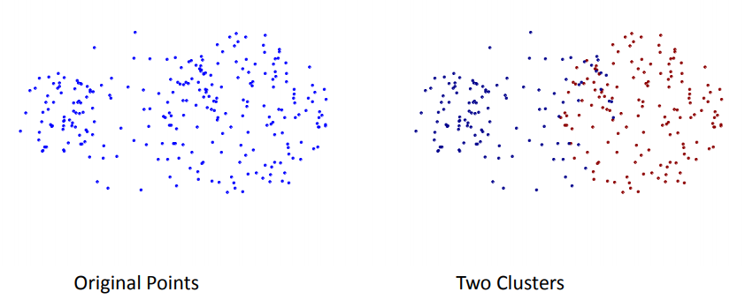
Single link method (Min)
Sensitive to noise and outliers

Slide 17
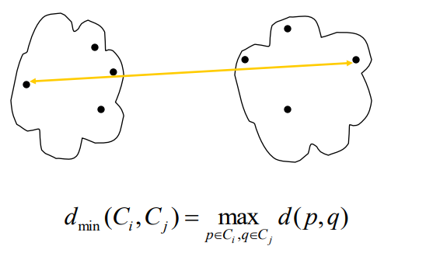
Complete link method (Max)
The distance between two clusters is represented by the distance of the farthest pair of data objects belonging to different clusters

Slide 18
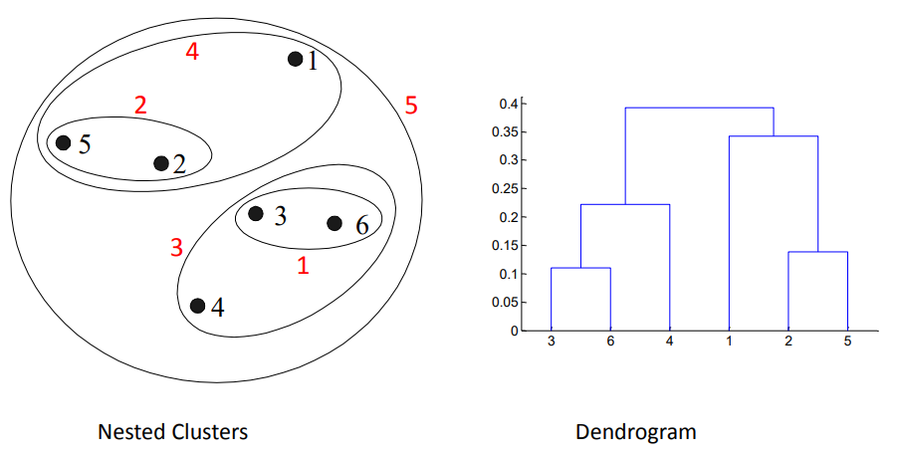
Complete link method (Max)

Slide 19
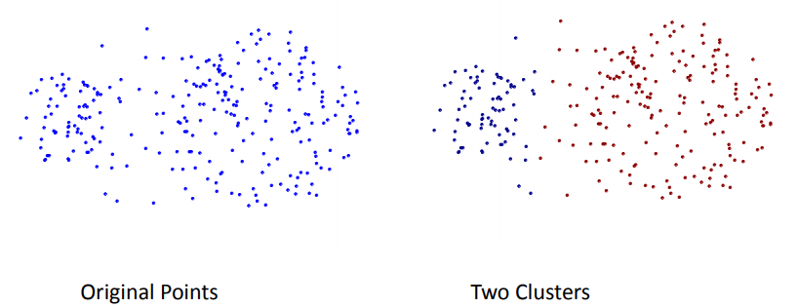
Complete link method (Max)
Less susceptible to noise and outliers

Slide 20
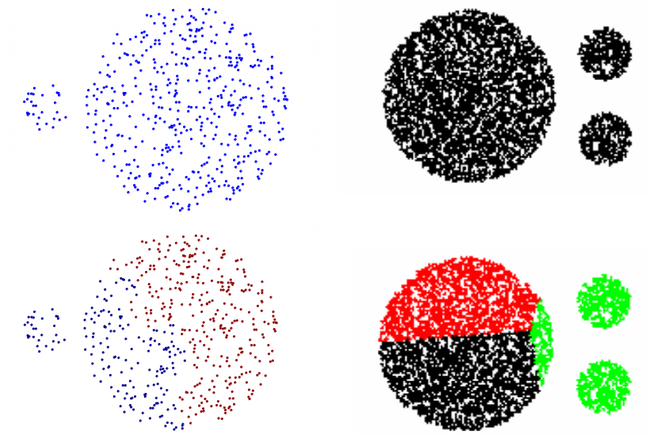
Complete link method (Max)
Tends to break large clusters

Slide 21
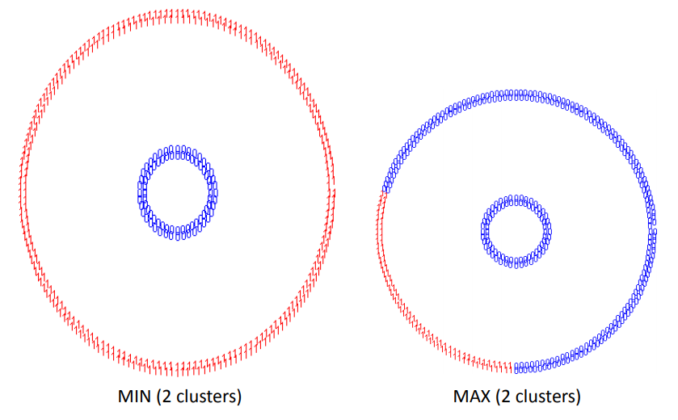
Complete link method (Max)
Biased towards globular clusters

Slide 22
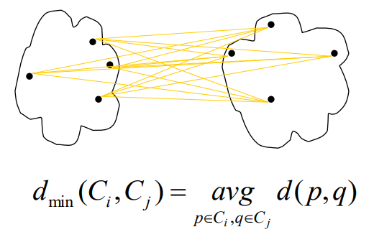
Average link (Group Average)
The distance between two clusters is represented by the average distance of all pairs of data objects belonging to different clusters
Determined by all pairs of points in the two clusters

Slide 23
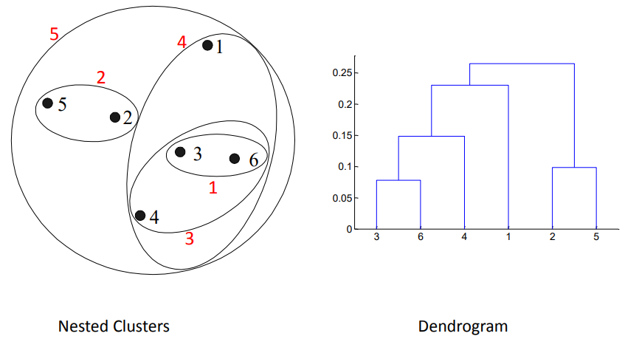
Average link (Group Average)

Slide 24
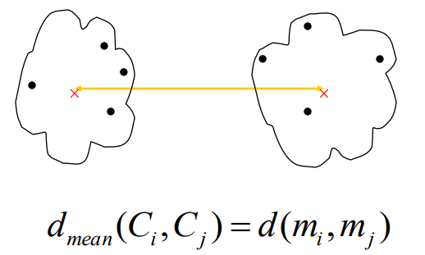
Centroid method (Distance between centroids)
The distance between two clusters is represented by the distance between the centers of the clusters
Determined by cluster centroids

Slide 25
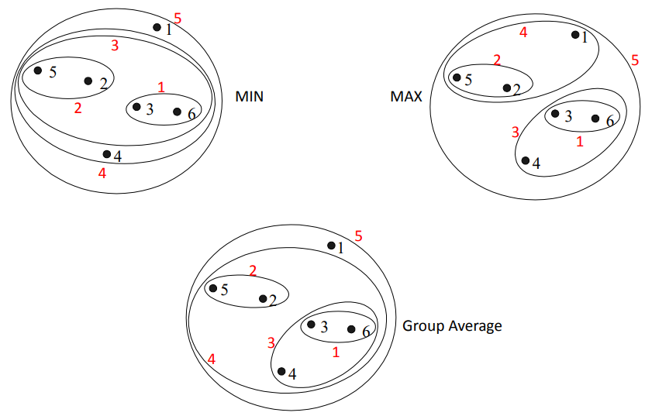
Comparison

